Slide 1
Mid-Latitude Cyclones
Cyclogenesis

Slide 2
Mid-Latitude Cyclones Outline
Definitions
Cyclogenesis
Polar Front Theory of Cyclogenesis
Conveyor Belt Model
Example of Mid-lat cyclone…

Slide 3
Cyclogenesis
Simply the formation of a cyclone.
Mid-Latitude cyclones are found, not surprisingly, within the Earth’s Mid-Latitudes (both hemispheres). Also Known As:
Extra-Tropical Cyclones
Wave Cyclones
These differ from cyclones that are found in the Tropics:
Tropical Depressions, Tropical Storms, Tropical Cyclones, Hurricanes, Typhoons, etc.

Slide 4
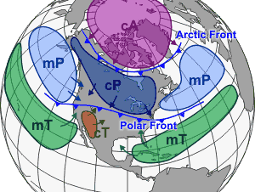
Cyclogenesis
Polar Front Theory Of Cyclogenesis
Implies that all mid-latitude cyclones form along the polar front.
5 stages of cyclone development

Slide 5
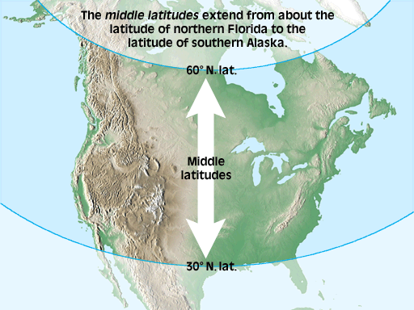

Slide 6
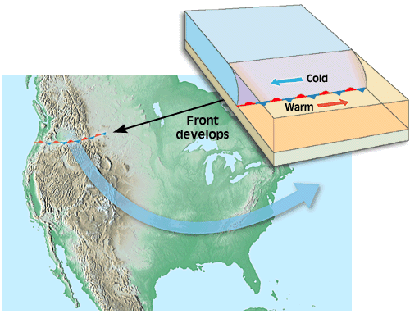
1. At Stationary Polar Front, warm subtropical air meets cold polar air.

Slide 7
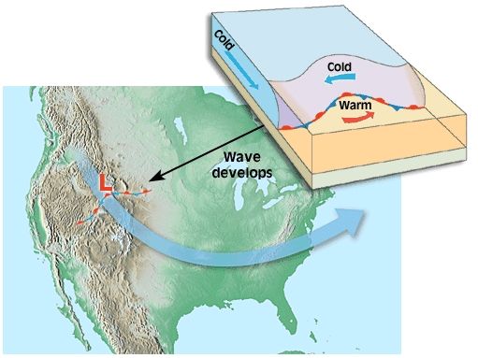
2. A disruption in the linear boundary, creates a kink & begins rotation

Slide 8
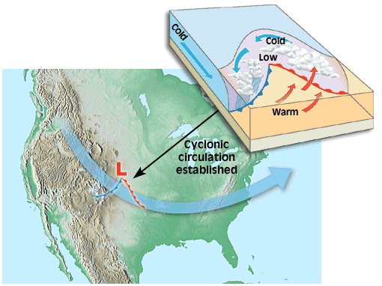
3. Low Pressure intensifies as the fronts distinguish themselves

Slide 9
3. This is known as the ‘Open Stage’

Slide 10
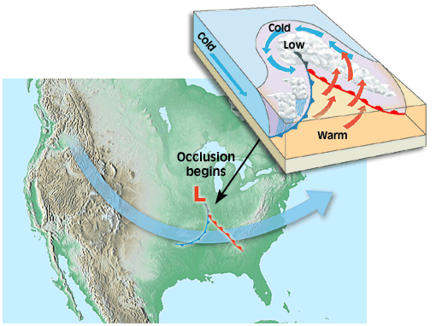
4. As Low intensifies & the fronts close together, an occlusion develops.

Slide 11
4. Occluded Front

Slide 12
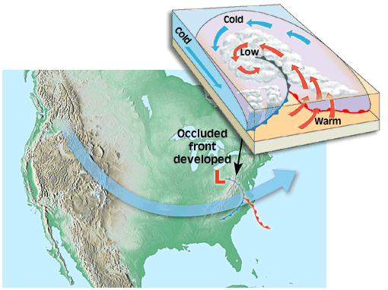
5. Entire system becomes occluded as warm air is lifted off the ground

Slide 13
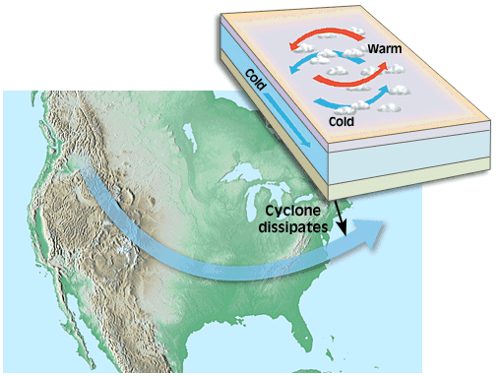
Eventually, the Low pressure dissipates & the storm is over.

Slide 14
Midlatitude Cyclones
Notes:
To view this animation, click “View” and then “Slide Show” on the top navigation bar.

Slide 15
Cyclogenesis
On a weather chart, one expects to see variations in:
Wind Direction,
Temperature And
Pressure
These changes stand out to indicate the cyclone.

Slide 16
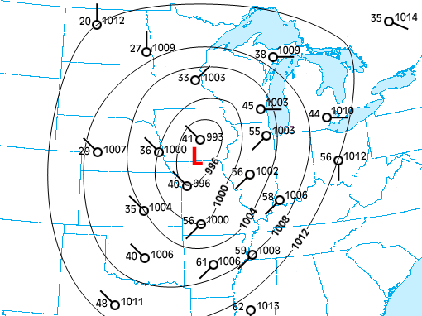

Slide 17
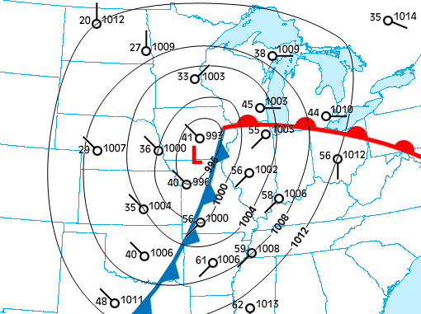
Probability of Precip. Increases toward the center of Low Pressure
Recall the type of clouds/precip. At each of the two fronts…
Note the wind patterns. What does this tell us about the source regions of air around this cyclone?

Slide 18
Cyclogenesis
We have explained what a Mid-Latitude cyclone is. But how is it formed?
Mid-Latitude Cyclones are driven by Dynamic Low Pressure systems.
This is contrary to Tropical Cyclones, which are driven by Thermal Low pressures systems.
You’ll recall that we expect to find Dynamic Low pressure where the Ferrel and Polar cells meet.
Hence, the Polar Front Theory of Cyclogenesis
However, the formation of Dynamic Lows are not exclusive to this Latitude!

Slide 19
Cyclogenesis
You’ll recall that both Low and High pressure systems can be formed dynamically
This is the result of upper level winds:
Converging
Diverging
This, in turn, is the result of upper level winds entering and exiting waves of troughs and ridges
These circle the Earth in a global pattern known as Rossby Waves

Slide 20
The Jet Stream and Rossby Waves
Notes:
To view this animation, click “View” and then “Slide Show” on the top navigation bar.

Slide 21
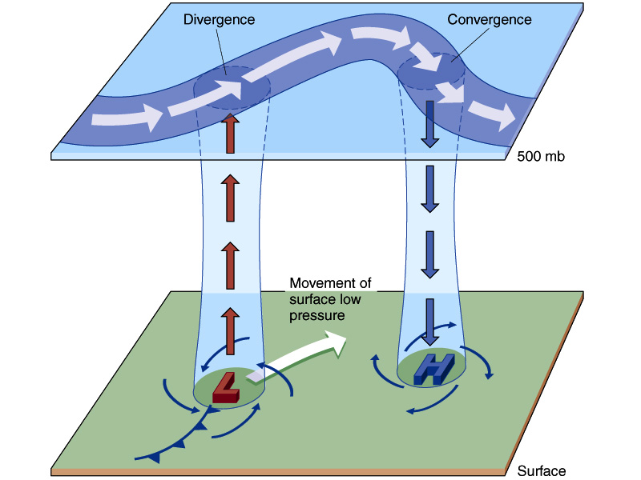

Slide 22
Vorticity
Vorticity: Measure of the amount “spin”
Something that spins with the earth or counter-clockwise is considered positive
Absolute Vorticity is total spin
Relative Vorticty is spin relative to earth
Earth Vorticity is spin of earth
Absolute Vorticity = Relative Vorticity + Earth Vorticity

Slide 23
Vorticity
Cyclones have positive relative vorticity
Anti-cyclones have negative relative vorticity
Earth vorticity zero at equator max at poles
If cyclone moves towards equator and it’s absolute vorticity is conserved, it’s relative vorticity will increase since earth vorticity decreases
Thus cyclones increase spin as they move equatorward and anti-cyclones decrease spin

Slide 24
Rossby Waves
Upper Level Westerlies do not flow parallel to lines of latitude but pattern of ridge and troughs as Rossby waves. WHY?
Small pertubation equatorward increases vorticity(counterclockwise) when flow returns poleward vorticity decreases (clockwise)
Wave propates depending on wind speed and wavelength and latitude
Larger wavelengths, lower latitudes and slower wind speed could lead to retrograde

Slide 25
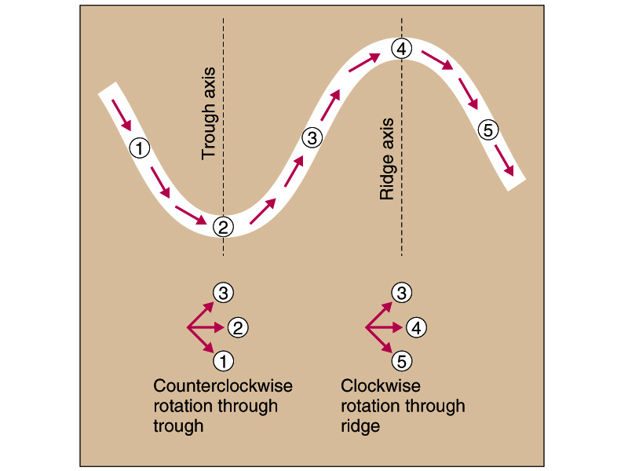

Slide 26
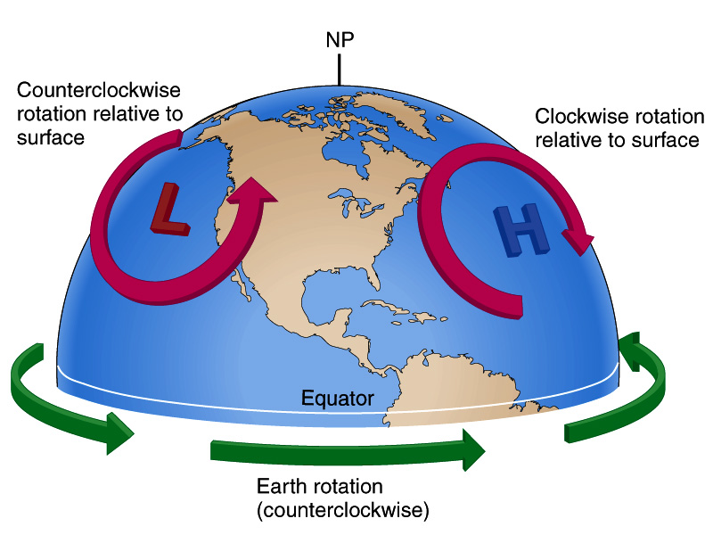

Slide 27
Cyclogenesis
Thus, Dynamic Lows at the surface may be initiated and maintained by diverging air aloft, just downwind of trough axes.
Convergence and Divergence will be greatest where winds are their fastest.
Naturally, we’d expect winds to be their fastest within the Polar Jet Stream.
The position of the Polar Jet Stream is determined by undulations in the Rossby Waves
In turn, this will determine the position of our Dynamic Lows

Slide 28
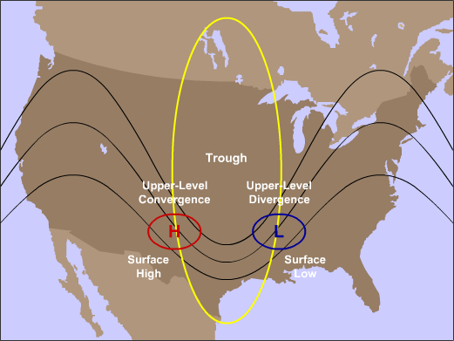

Slide 29
Cyclogenesis
We have described:
What a Mid-Latitude Cyclone looks like at the surface.
What conditions are required aloft to develop and maintain a Dynamic Low
However, it is important to remember that the atmosphere acts as a whole.
Thus, we must examine the 3-D structure of a Mid-Latitude Cyclone
Apply the Conveyor Belt Model

Slide 30
Cyclogenesis
Conveyor Belt Model:
A conveyor belt describes the flow of air that maintains its structure even as it turns, changing its direction and altitude
There are 3 prominent conveyor belts within a Mid-Latitude cyclone:
Dry – Fast, high altitude wind
Warm – Blowing from the south at low levels
Cold – Easterly wind

Slide 31
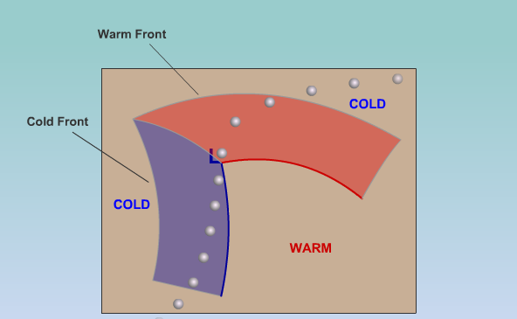
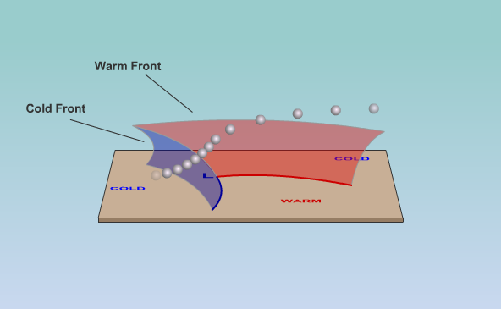
Dry Conveyor Belt
High altitude winds blow generally from the SW along the eastern side of the trough.
Swings to the NE above the center of the cyclone. Maintains the Low through Divergence
Prevents air mass mixing

Slide 32
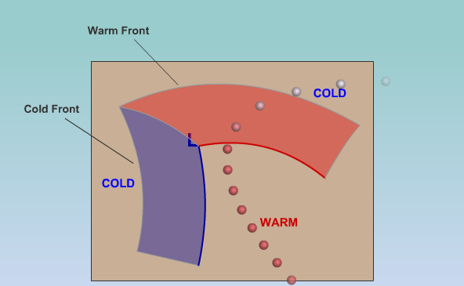
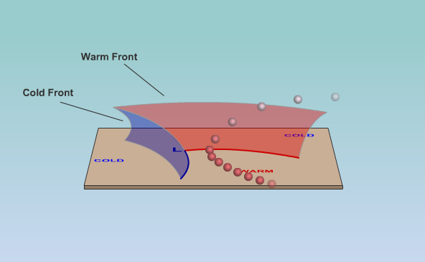
Warm Conveyor Belt
Low level, moist air enters from the south
Cools as it rises up the warm front
Joins up with the westerly flow aloft
Important source of moisture for the storm (clouds, precipitation)

Slide 33
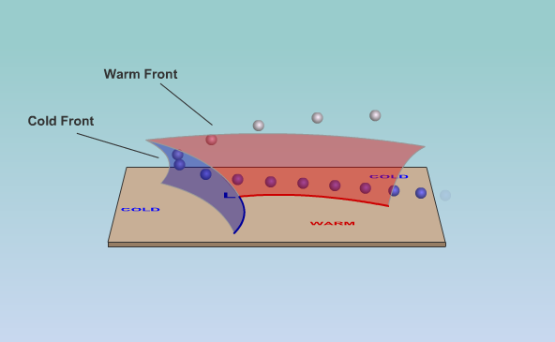
Cold Conveyor Belt
Enters from the east at low levels in the cold air poleward of the warm front
Slowly rises as it travels to the NW part of the storm
Turns to the N and then E as it encounters the westerly winds aloft
Lifting causes precip. In NW part of the storm.

Slide 34
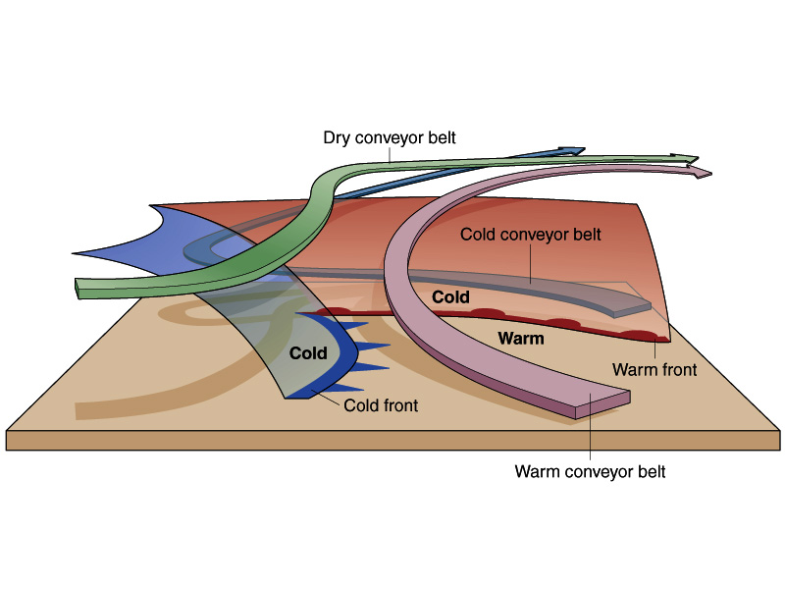

Slide 35
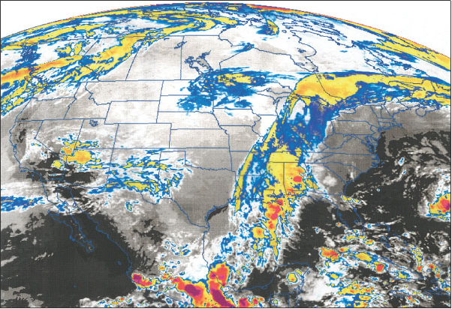

Slide 36
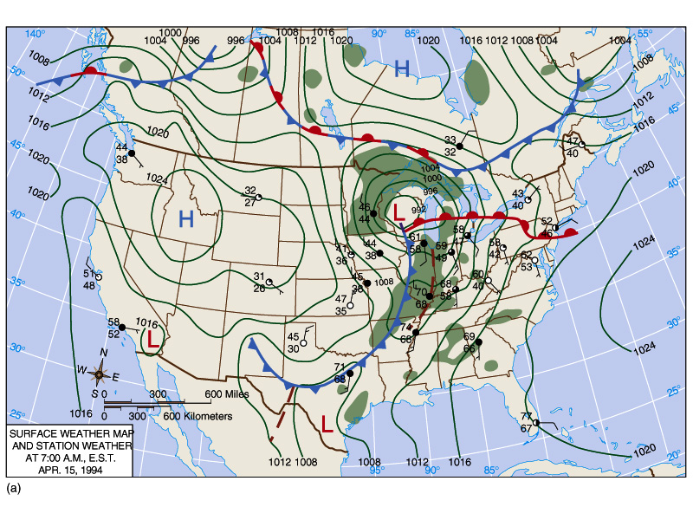

Slide 37
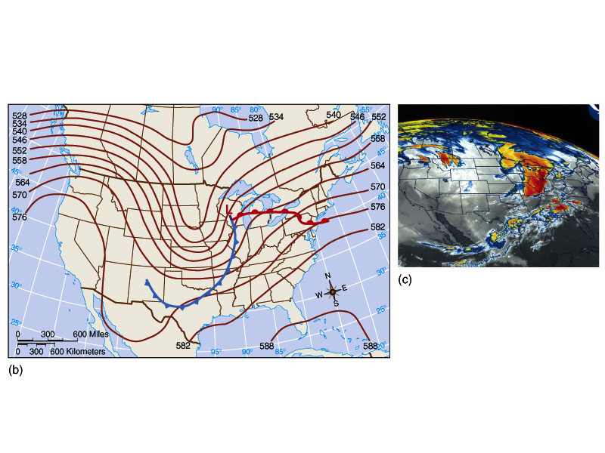

Slide 38
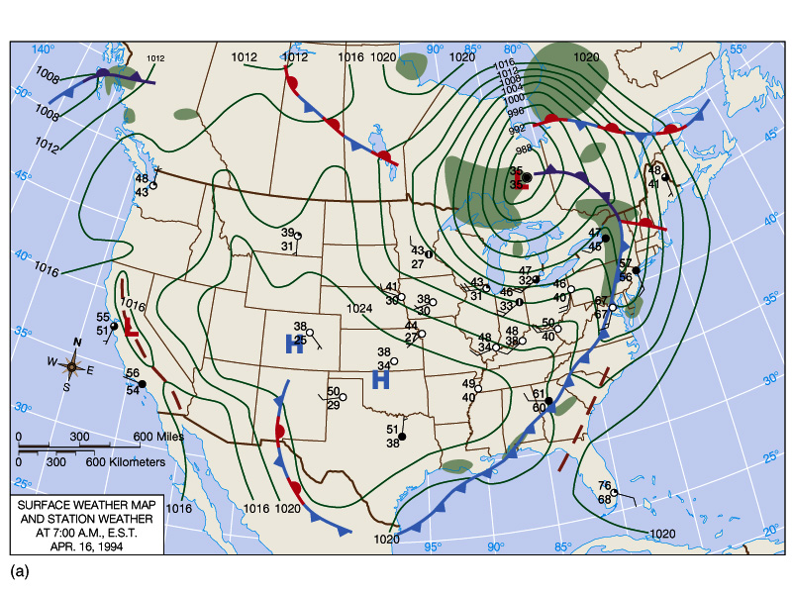

Slide 39
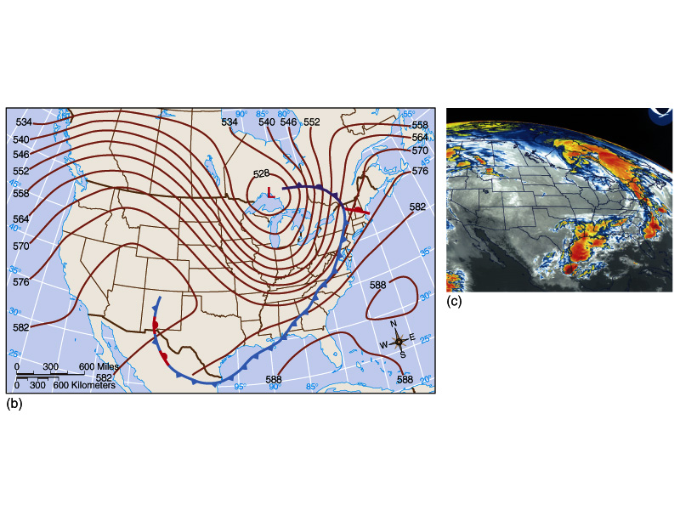

Slide 40
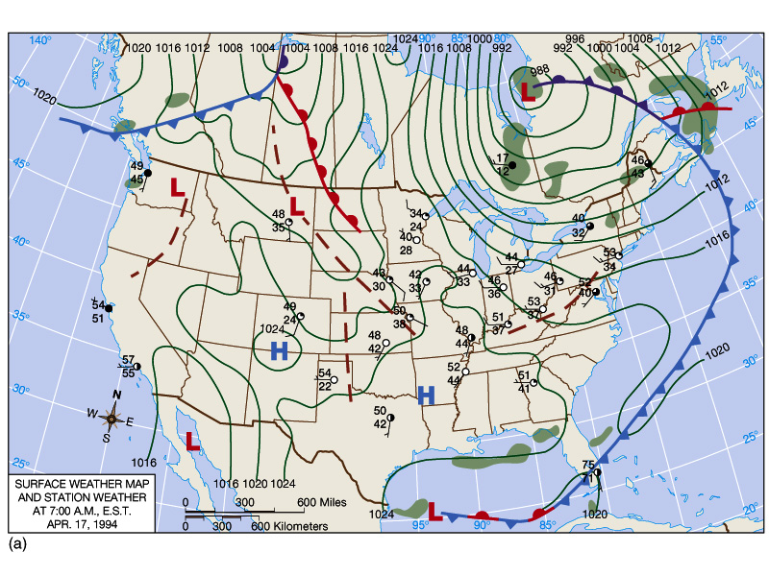

Slide 41
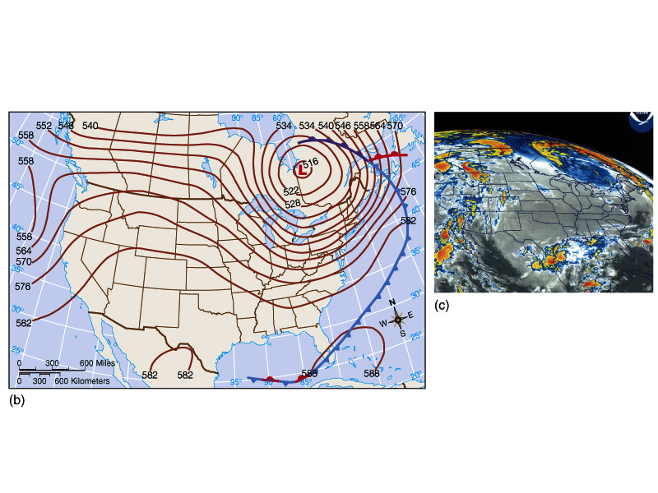

Slide 42
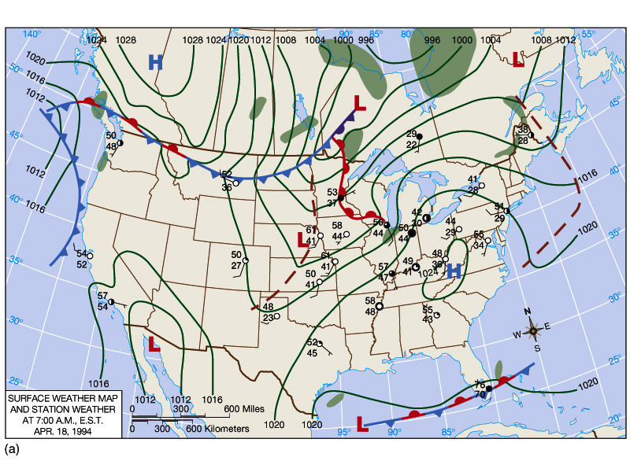

Slide 43
